Slide 1

22AIE214 Mathematics for computing-4
22MAT230 Introduction to Robotics Automatic Forklift Prototype
Group C-06
Varshitha Thilak Kumar - CB.SC.U4AIE23258
Siri Sanjana S - CB.SC.U4AIE23249
Shreya Arun- CB.SC.U4AIE23253
Anagha Menon - CB.SC.U4AIE23212

Slide 2
Introduction
Definition: A forklift is an industrial vehicle designed to lift and move heavy materials over short distances.
Components: Equipped with a set of forks for lifting and transporting goods.
Navigation: Operated by a driver, using forks to lift and move materials.

Slide 3
Problem Statement
Inefficient Traditional Forklifts: Conventional forklifts are too large, manually demanding, and ill-suited for small warehouses, causing inefficiencies and safety hazards in material handling.
Safety and Environmental Concerns: Manual operations in confined spaces risk accidents and load instability, while high energy consumption raises sustainability issues, calling for smarter, eco-friendly solutions.

Slide 4
Objective
"Design of a semi-automated, eco-friendly forklift suitable for small warehouses."
This project aims to develop a smart forklift prototype using Mecanum wheels for omnidirectional movement and a Raspberry Pi 4 for remote control via an Android phone.
The forklift will feature a gyroscope sensor (MPU6050) on the fork, enabling real-time motion analysis and signal processing using FFT, STFT, and wavelet transform (WT).
The lifting mechanism will be driven by a stepper motor, ensuring precise load handling.

Slide 5
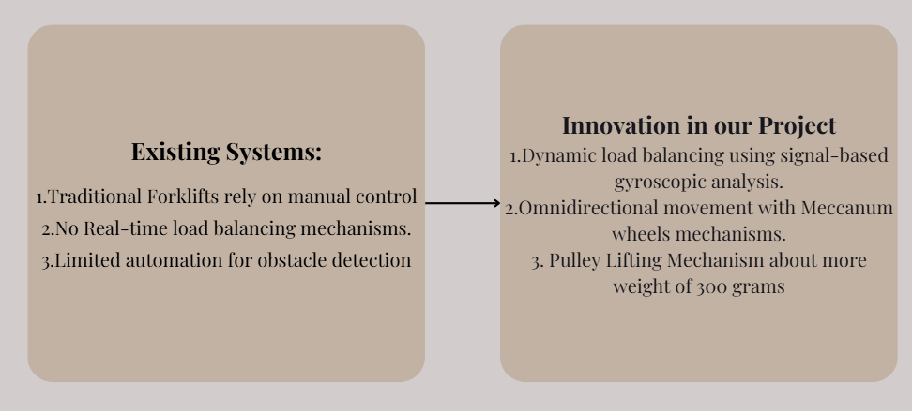
Innovation

Slide 6
Components:
Coupler | Horizontal Rod Holder
1000m long rod 12 mm | Vertical Rod Holders
Linear Ball bearing | Long Screws
Pulley Teeth 6mm | 8mm Rod
Pulley Belt

Slide 7
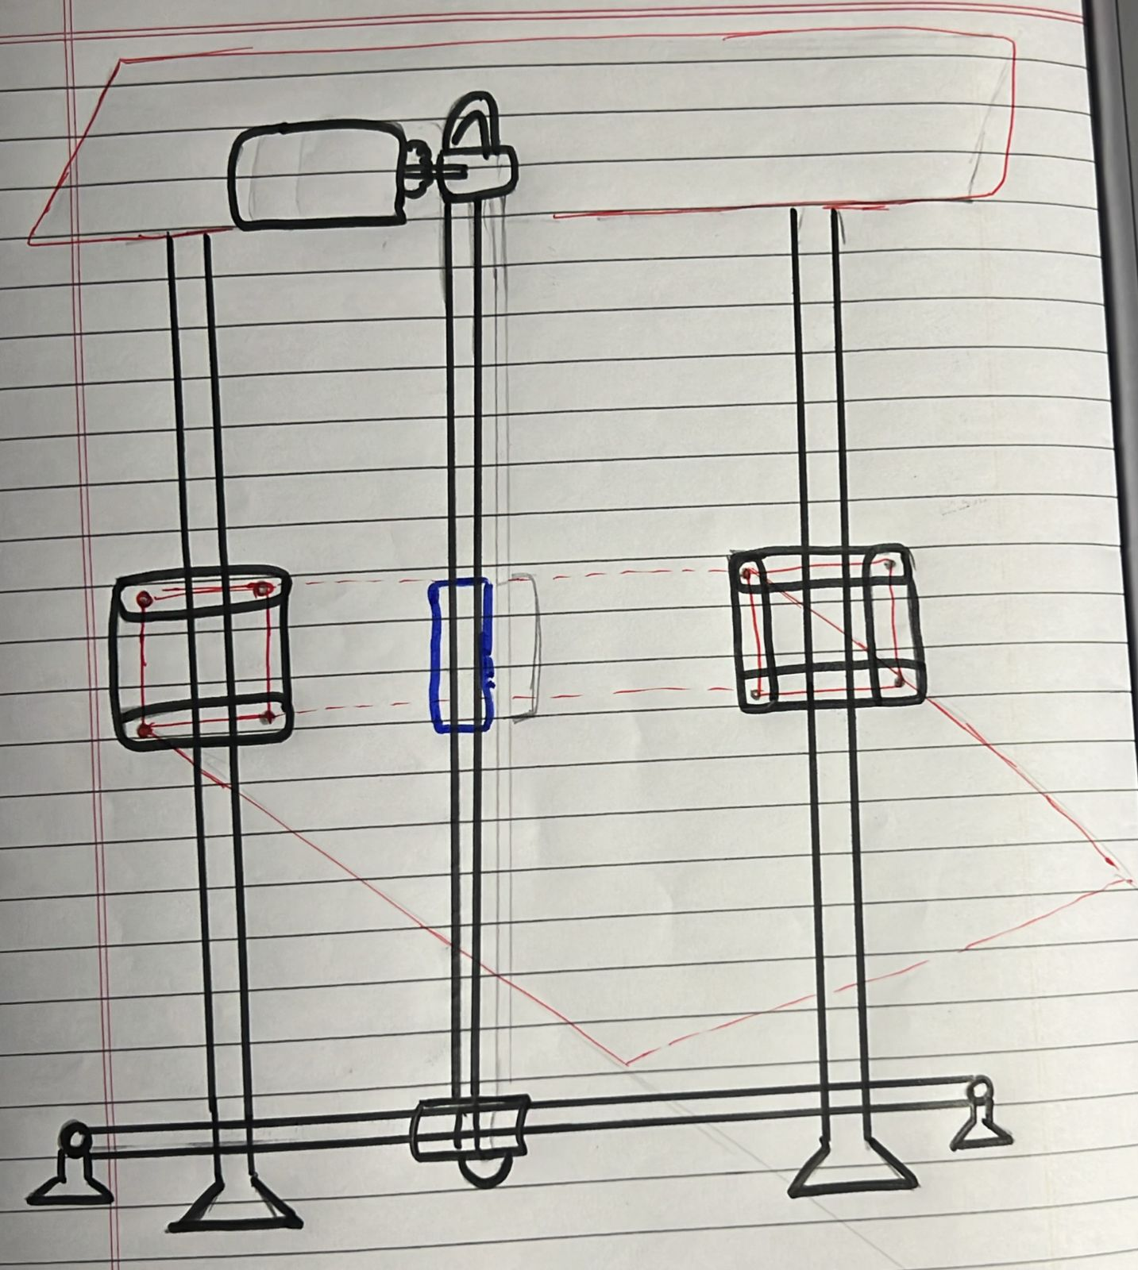
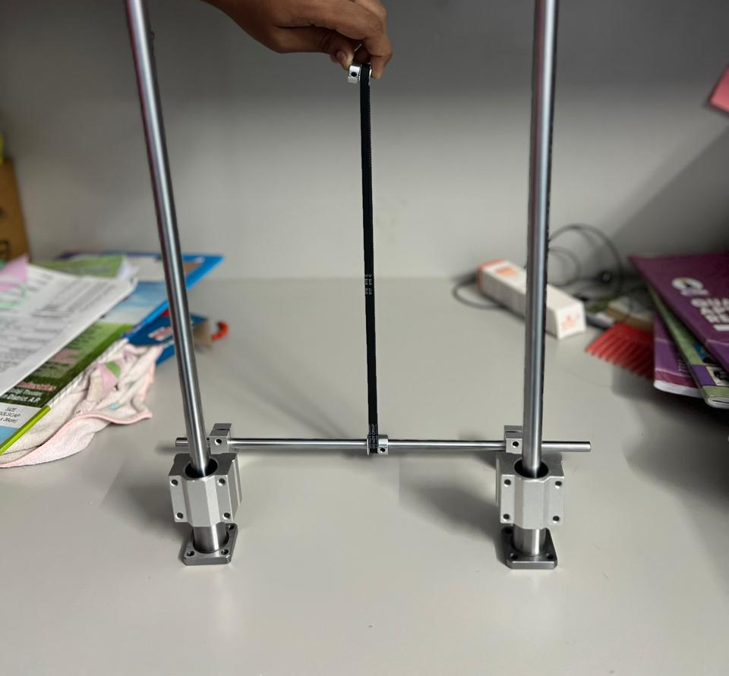
The Lifting Ideology:

Slide 8
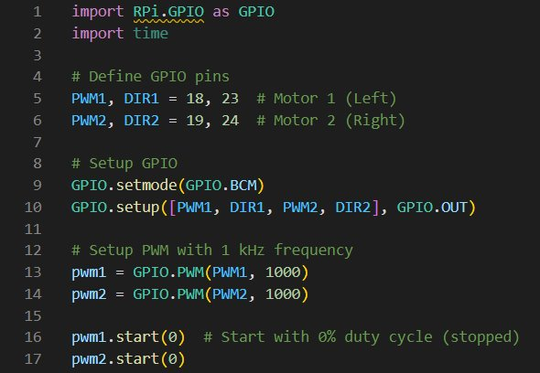
Working of Mecanum Wheels
Libraries Used:
RPi.GPIO – Controls Raspberry Pi’s GPIO pins.
time – Introduces delays for motor operations.
Pin Assignments:
PWM1 (18), DIR1 (23): Controls the left motor.
PWM2 (19), DIR2 (24): Controls the right motor.
PWM Configuration:
The motors are controlled using Pulse Width Modulation (PWM) at 1 kHz frequency.
Both motors start at 0% duty cycle (stopped state).

Slide 9
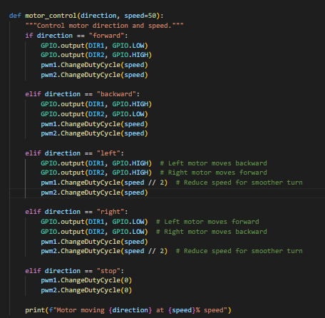
Motor Control Functions:

Slide 10
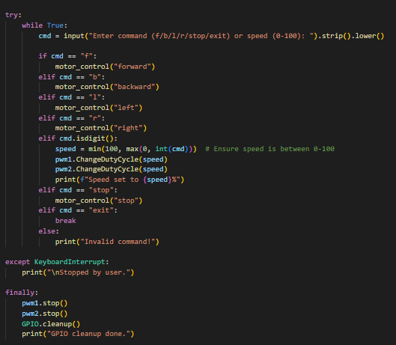
User Input Handling

Slide 11
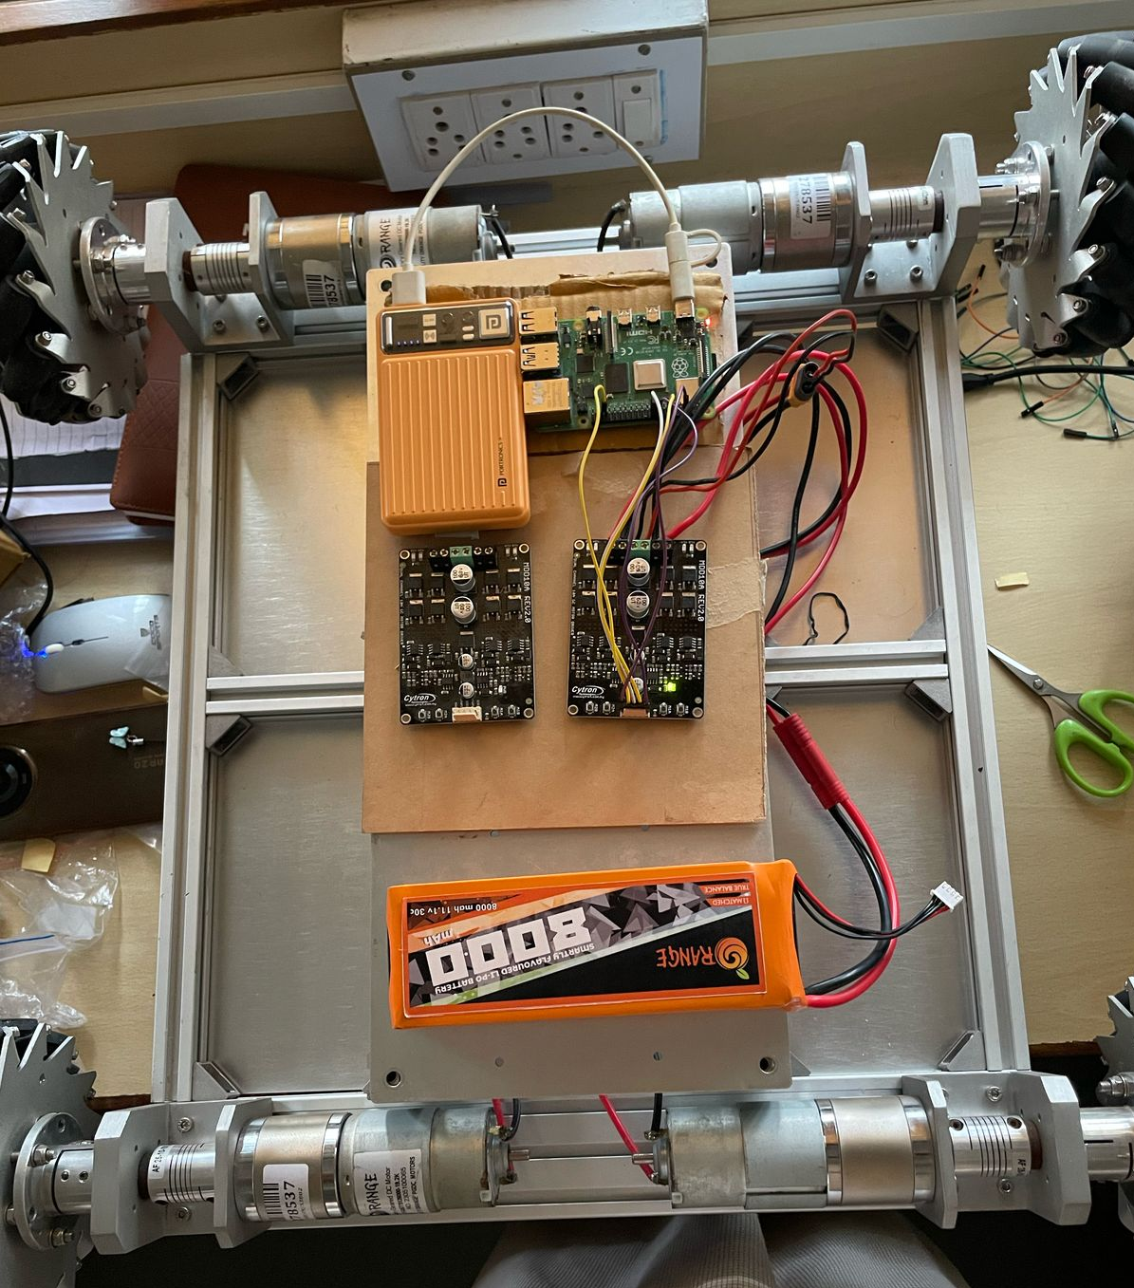
Demo

Slide 12
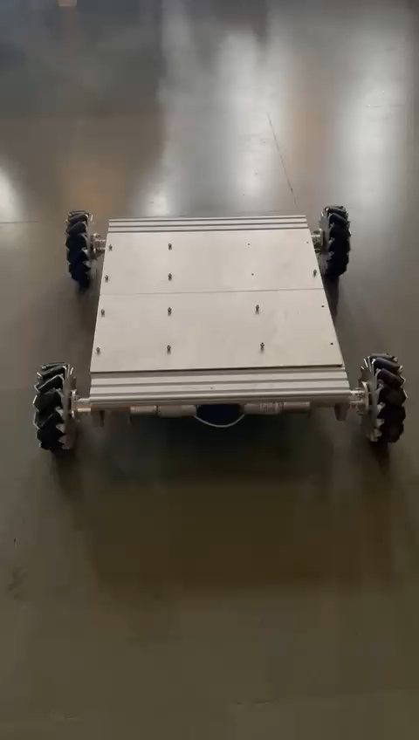
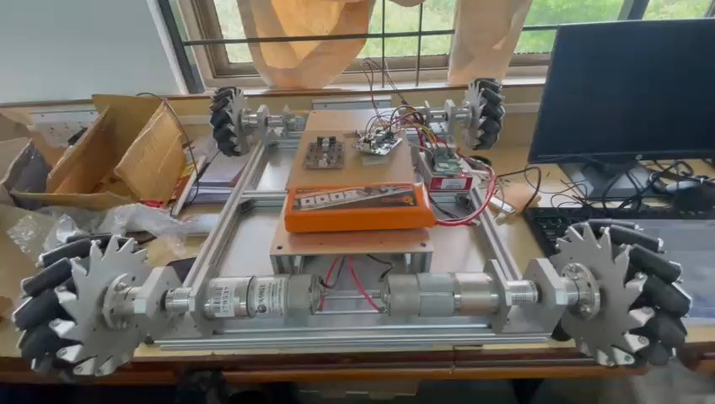
Demo

Slide 13
Stepper Motor Working:
Stepper motors rotate in discrete steps by energizing coils in a precise sequence.
Magnetic Attraction & Repulsion:
The stator (stationary part) has coils, and the rotor (moving part) has permanent magnets.
When a coil is energized, it creates an electromagnetic field that attracts or repels the rotor magnets.
The coils are activated in a specific order, making the rotor align with the energized stator pole.
Microstepping Mode:
By adjusting the current through the coils, finer steps can be achieved for smoother rotation.

Slide 14
Stepper motor Exciting Sequence
A bipolar stepper motor has two coils (A and B), each with two terminals:
Coil 1 (A, A’)
Coil 2 (B, B’)
A. Full Step Sequence (Wave Drive)
Energize Coil 1 (A-A’) → Rotor aligns
Energize Coil 2 (B-B’) → Rotor moves 90°
Energize Coil 3 (A-A’) Reverse → Rotor moves 90°
Energize Coil 4 (B-B’) Reverse → Rotor moves 90°
The A4988 stepper motor driver controls how these coils are energized, creating a rotating magnetic field that moves the rotor step by step.

Slide 15
Coils and Magnetic Fields
Steps | A1 | A2 | B1 | B2 | Angle
1 | + | - | + | - | 0 deg
2 | - | + | + | - | 90 deg
3 | - | + | - | + | 180 deg
4 | + | - | - | + | 270 deg
5 | Repeat these for rotation

Slide 16
Microstepping
Microstepping allows for smoother motion and higher precision by adjusting the current in the coils. Instead of making full steps, the motor can move in fractional steps, reducing vibrations.
MS1 | MS2 | MS3 | Step Mode | Steps per Revolution
Low | Low | Low | Full Step | 200
High | Low | Low | 1/2 | 400
Low | High | Low | 1/4 | 800
High | High | Low | 1/8 | 1600
High | High | High | 1/16 | 3200

Slide 17
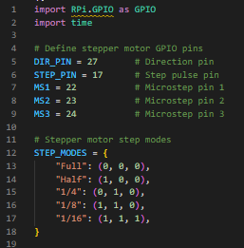
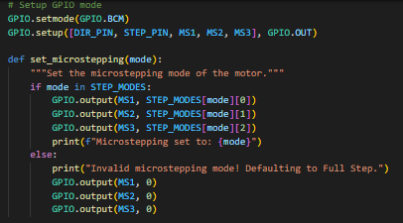
Working of Stepper motor

Slide 18
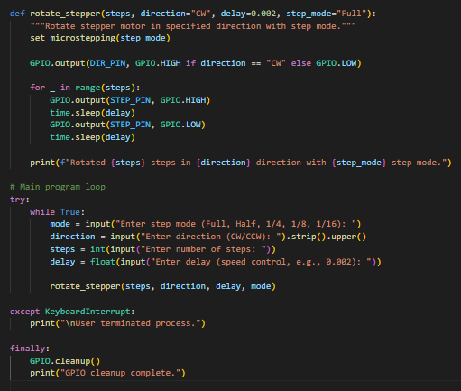
Working of Stepper motor

Slide 19
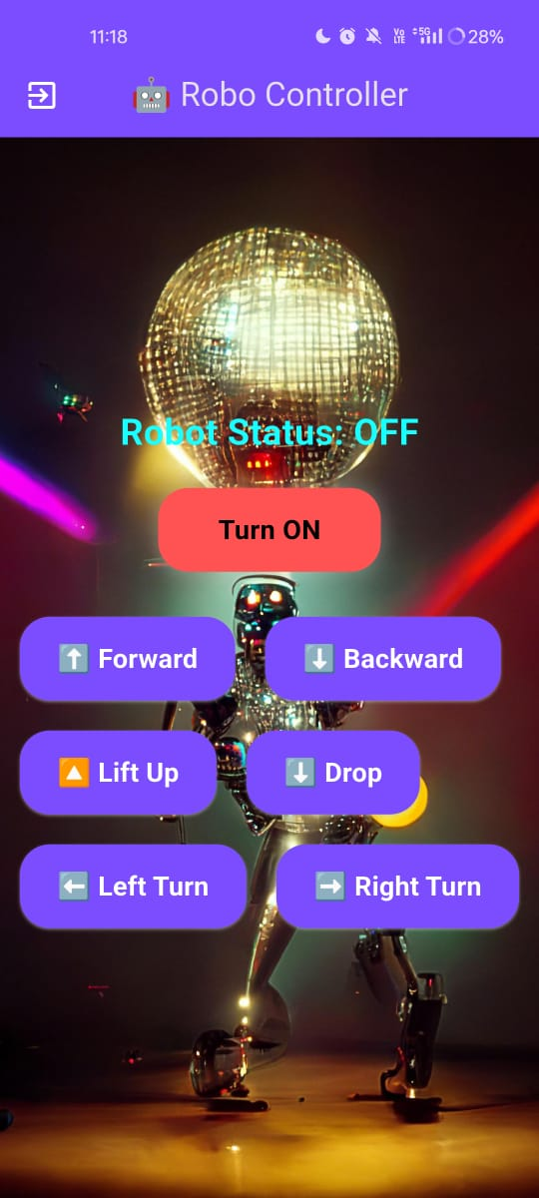
Working of both together

Slide 20
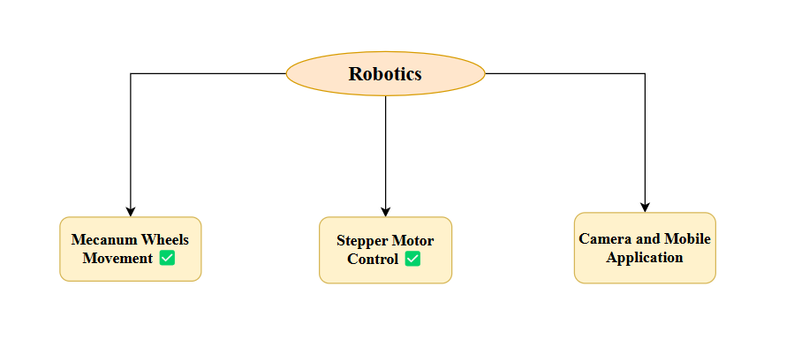
Current Status

Slide 21

Mathematics for Computing (MFC) – Robotics Project
Mathematical Analysis of Load Balancing in Forklifts Using Signal Processing

Slide 22

Mathematical Problem Statement
Given a forklift tilt angle θ(t) over time, we need to predict instability and apply corrections using mathematical transformations.
01
Analyze the dataset (X, Y, Z tilt values from MPU6050) to compute frequency variations.
02
Use FFT, STFT, and WT to analyze forklift stability in frequency-time domains.
03

Slide 23
Mathematical Representation of Tilt Using Accelerometer & Gyroscope
X,Y,Z→ Accelerometer values
ωx,ωy,ωz → Gyroscope angular velocities

Slide 24
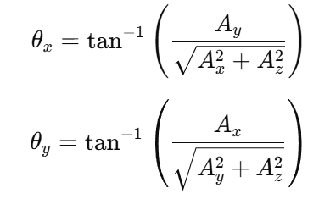
MPU6050 Sensor Readings
Accelerometer Equation (Tilt Estimation) Measures the tilt itself

Slide 25
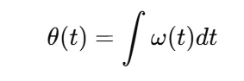
Gyroscope Integration (Angular Displacement)
real tilt equations used for computing load imbalance.
Measures how fast the tilt is changing

Slide 26
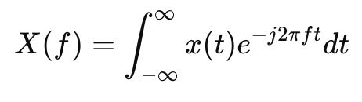
FFT (Fast Fourier Transform) – Frequency Analysis
What is FFT?
FFT converts a time-domain signal (tilt data) into a frequency-domain signal.
Helps find vibrations & periodic patterns in forklift tilt but loses time information. Mathematical Equation

Slide 27
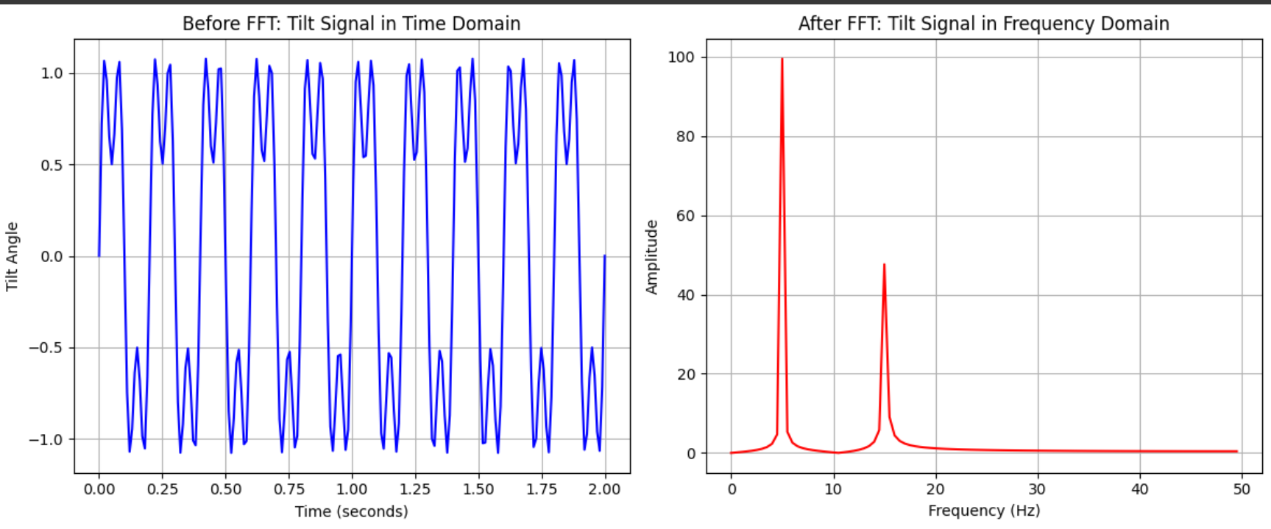
GRAPH REPRESENTATION
Limitations of FFT
Loses time information → Can’t tell when tilt happens. Only good for periodic signals → Forklift tilt is random, not periodic.

Slide 28
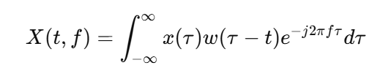
STFT (Short-Time Fourier Transform) – Time-Frequency Analysis
What is STFT?
STFT improves FFT by applying FFT in small time windows.
Helps track when tilt changes occur but has a fixed window size issue.
Mathematical Equation

Slide 29
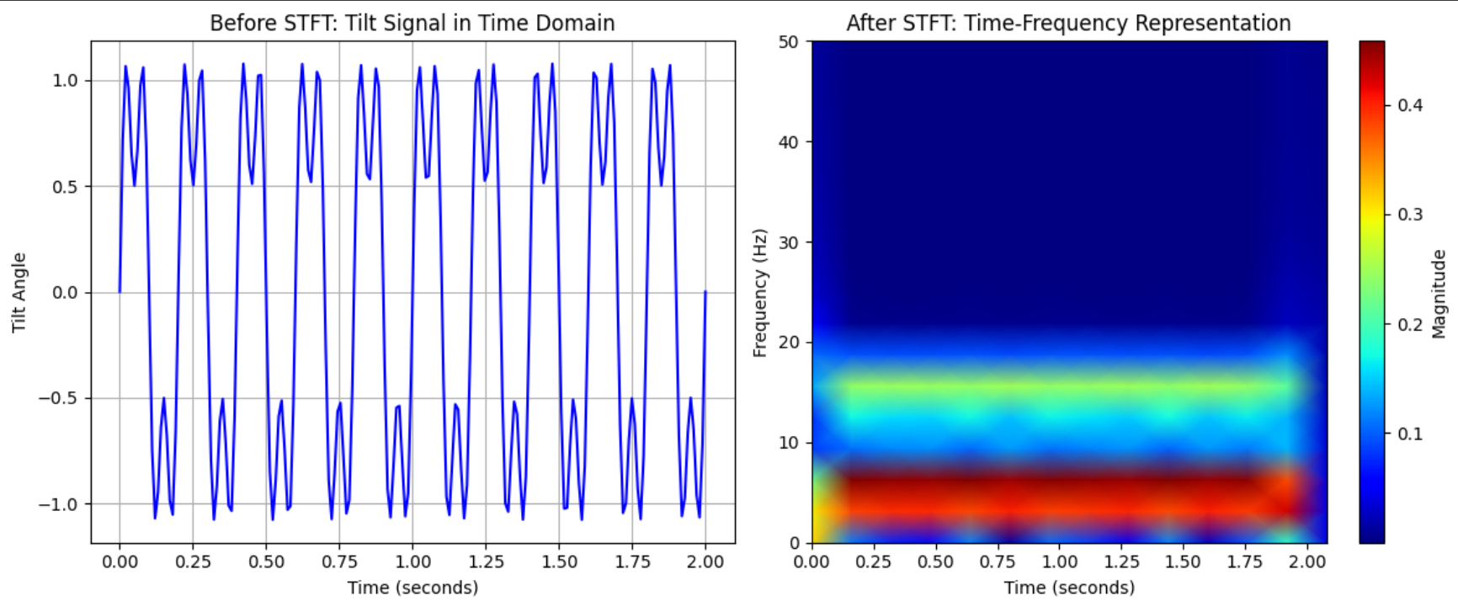
GRAPH REPRESENTATION
Limitations of STFT
1.Fixed window size problem →
Small window = good time resolution, bad frequency resolution.
Large window = good frequency resolution, bad time resolution. 2.Fails to detect both slow & fast tilt variations together.

Slide 30
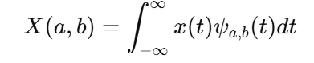
WT (Wavelet Transform) – Multi-Resolution Analysis
What is WT?
WT breaks the tilt signal into different scales, capturing both fast & slow tilt changes.
Works like zooming in & out to see both small and large tilts clearly. Mathematical Equation

Slide 31
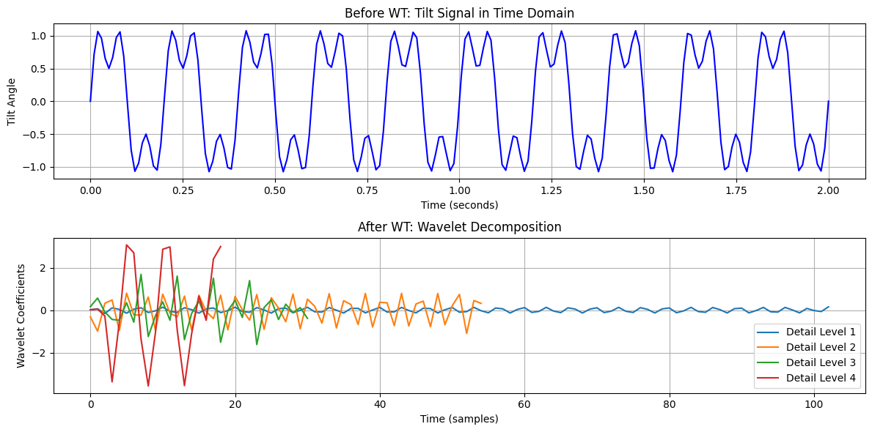
Before & After Wavelet Transform on Tilt Signal

Slide 32
Why WT is the Best?
WT Adapts to Real Forklift Tilt Movements
FFT & STFT struggle with sudden jerks & slow shifts.
WT detects both in real-time → Best for load balancing.
No Fixed Window Problem
STFT is stuck with one window size. WT adapts dynamically.
Perfect for Real-Time Corrections
Since WT captures all tilt variations, we use it to adjust lift height dynamically:

Slide 33
Comparsion
Method | Captures Time Info? | Captures Frequency Info? | Handles Slow & Fast Tilts? | Best for Forklift?
FFT | NO | YES | NO | NO - Only detects steady vibrations
STFT | YES (BUT LIMITED) | YES | NO | NO - Can miss tilt details
WT | BEST | YES (WITH ACCURACY) | BEST | YES - Can detect & correct tilts dynamically

Slide 34
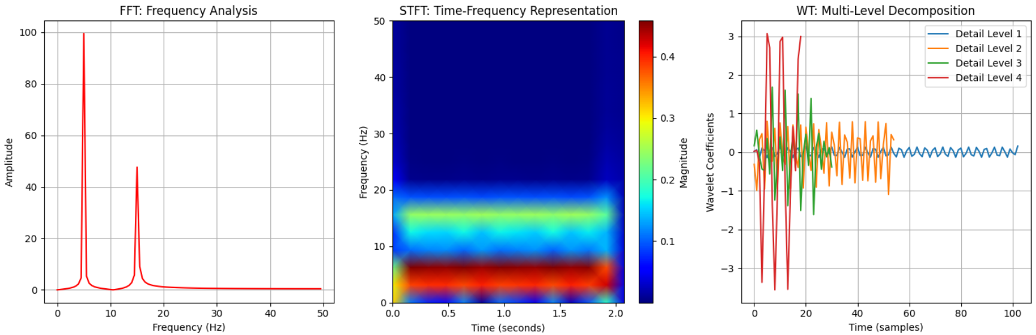
Comparison

Slide 35
Future Work
Implement the Lifting Mechanism
Check the working of stepper motor
Integrate wheels movement with android studio
Combine the mecanum wheels and lifting mechanism
Implement load Balancing using WT
Integrate camera to the project and connect that to android studio for automation.

